Slide 1
Bullet Proofing Your
Estate Plan

Slide 2
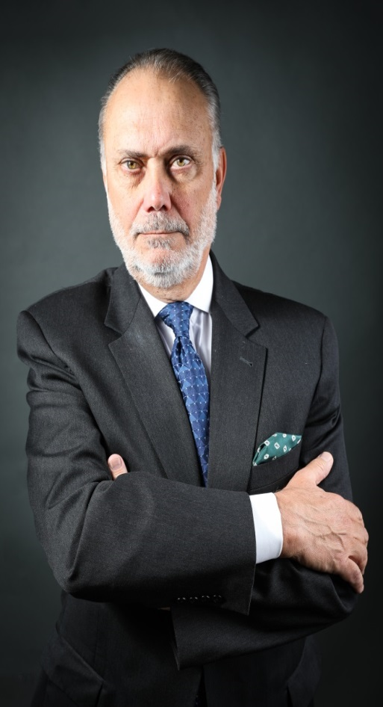
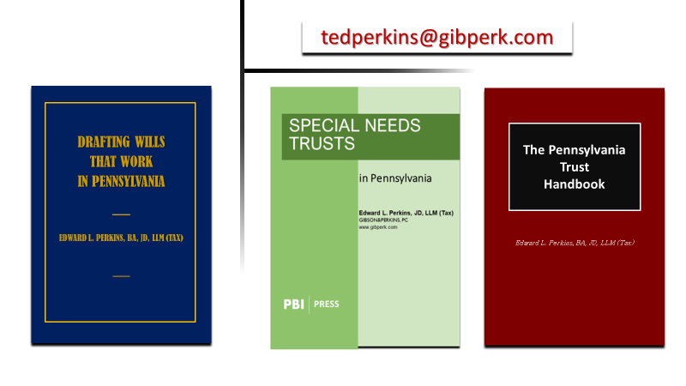
Edward L. Perkins, BA, JD, LLM(Tax), CPA

Slide 3
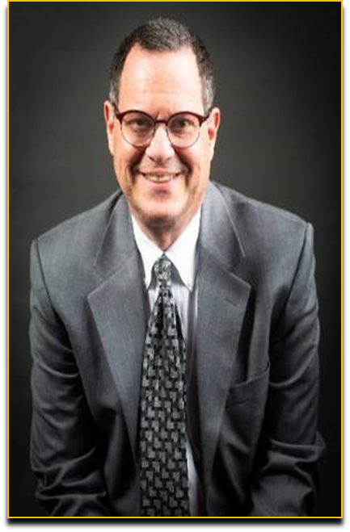
MARTIN J. PEZZNER, BS, JD, CPA
Gibson & Perkins, PC
mpezzner@gibperk.com
610.565.1708 ext. 112
Mr. Pezzner has a wealth of experience as a practicing attorney for over twenty-nine years. After graduating Wilkes College with a Bachelor of Science in accounting, he was employed by the Internal Revenue Service in Philadelphia, PA as a Tax Revenue Agent (Field Agent) for five years. He also worked for one year in the Philadelphia IRS Appeals Office. While employed by the IRS, he became a CPA (1985) in the Commonwealth of Pennsylvania. Mr. Pezzner received his Juris Doctorate Degree from the University of Dayton School of Law in 1989.
Mr. Pezzner is admitted to practice in the Commonwealth of Pennsylvania and the Eastern District of Pennsylvania. Well-versed in all aspects of law, he is especially knowledgeable in the realms of Estate Administration, Estate Planning, Business Matters, and Tax Controversies.
He is a member of the Philadelphia Bar Association and the Probate and Trust Law Section of the Philadelphia Bar. He also maintains his CPA license.

Slide 4
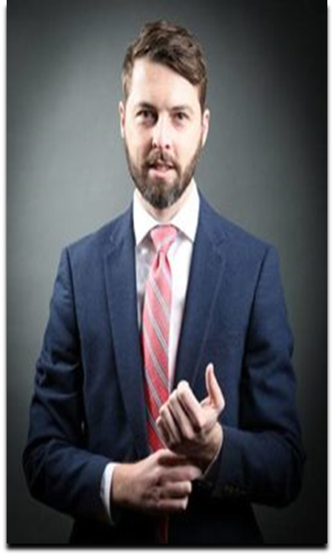
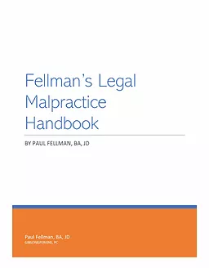
Paul Fellman
Licensed in Pennsylvania
​
Paul is a Senior Associate in Gibson & Perkins’ Litigation Department where he represents clients in personal injury, legal malpractice, and general liability matters. The pride he takes in his work is reflected in the results he achieves for his clients.
​
Paul enjoys the complex nature of legal malpractice matters and takes each case as an opportunity to deepen his knowledge of the law.
​
In addition to his trial practice, Paul has extensive experience in the area of appellate practice. Paul has argued cases before Pennsylvania’s Supreme Court, Superior Court, and Commonwealth Court. While attending law school, Paul served as a judicial extern to the Honorable Henry duPont Ridgely of the Delaware Supreme Court.
​
Paul is the author of Fellman’s Legal Malpractice Guide

Slide 5
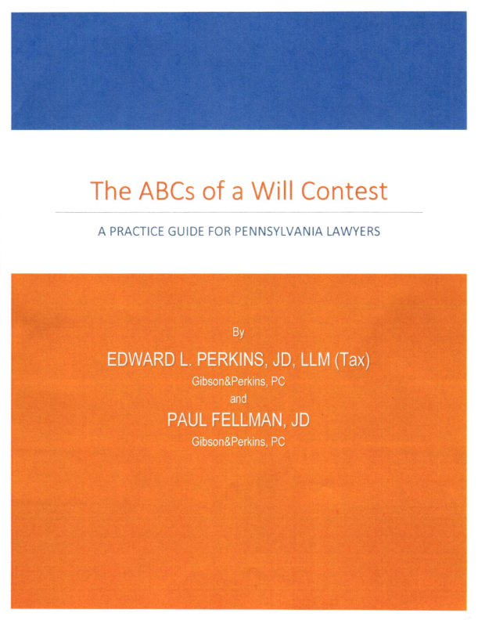
https://www.pbi.org

Slide 6

Suite 204
100 W Sixth Street
Media, PA 19063
610 565 1708
www.gibperk.com
www.youronlineprofessor.net

Slide 7

GIBSON&PERKINS, PC is a multi-practice law firm with offices in Pennsylvania and Delaware. Our firm has expanded from its founding in 2001, into a vibrant and growing law firm dedicated to serving an ever expanding and sophisticated client base.
We represent clients in matters pertaining to:
Business Transactions
Real Estate
Estate Planning
Estate Administration
Tax Problem Resolution
Emerging Businesses
Litigation

Slide 8
YourOnLineProfessor.net
CLE - Continuing Legal Education for
Attorneys:
YourOnlineProfessor.net is an Accredited Provider for Pennsylvania Continuing Legal Education, through The Supreme Court of Pennsylvania's Continuing Legal Education Board, registered as sponsor #7003.
This program qualifies as 1 hour - ‘Live Webcast’ under PA CLE Board guidelines and in the states of Delaware, New Jersey, California, and Texas
In most cases, credit is also available to New York attorneys through New York’s “approved jurisdiction policy.”

Slide 9
YourOnLineProfessor.net
CPE - Continuing Professional Education for
CPAs:
YourOnlineProfessor.net is registered with the Pennsylvania Department of State's Bureau of Professional and Occupational Affairs as a Program Sponsor under the State Board of Accountancy. Our license number is PX177605.
This Course will count as 1.0 Hour of Group Internet Based or
Interactive Self Study Credit depending on how you access the Course.
For CPAs taking an archived version of the Course for Interactive Self Study Credit successful completion of a Final Examination is required. The Final Slide will direct you as to how to access and complete the Final Examination.

Slide 10

NASBA Registry of CPE Sponsors
YourOnlineProfessor.net is registered with the National Association of State Boards of Accountancy (NASBA) as a sponsor of continuing professional education on the National Registry of CPE Sponsors. State boards of accountancy have final authority on the acceptance of individual courses for CPE credit. Complaints regarding registered sponsors may be submitted to the National Registry of CPE Sponsors through its website: www.learningmarket.org.
Our Sponsor No. Identification Number 137573

Slide 11
Refund Policy
It is the policy of YourOnlineProfessor.net to satisfy participants and purchasers in a reasonable manner. Therefore, refunds to dissatisfied participants will be given in order to maintain good will. However, the reason for a participant's dissatisfaction and any resulting refund must be clearly indicated. Each refund request will be reviewed by a majority of the members of YourOnlineProfessor.net. A refund is always given if a course does not qualify for CPE credit in the state in which the purchaser seeks to apply it for credit.
Program Cancellation Policy
It is the policy of YourOnlineProfessor.net to refund any fees paid in full in the event that a scheduled program is cancelled or rescheduled.
Complaint Resolution Policy
All evaluations are reviewed by Edward Perkins. Grievance complaints are directed to Mr. Perkins at (610) 565-1708 ext. 2 or via email to yop@youronlineprofessor.org. It is the policy of YourOnlineProfessor.net to respond to every grievance complaint. This response shall include when appropriate: reviewing the grievance complaint in conjunction with other participant evaluations and discussion of the grievance complaint with the course instructor or other employees.

Slide 12
Where Applicable, this program is
© YourOnlineProfessor.net - All Rights Reserved.
This material is designed for informational purposes. In providing this material, neither the author nor YourOnlineProfessor.net are engaged in rendering legal, accounting or professional service. If legal, accounting, or professional service is required, the service of a competent professional should be sought.
Inquiries regarding the use of the material contained in
this Course should be addressed to:
Ted Perkins
tperkins@gibperk.com
Suite 204
100 W. Sixth Street
Media, PA 19063

Slide 13
Verifying Your Attendance
Attendees will be asked to periodically verify their attendance in order to comply with CPE/CLE guidelines.
This involves typing “I’m still here!!! into
the chatbox and pressing ‘Enter’ when prompted.
It is important that you follow all such prompts
in order to ensure that your CPE/CLE credits
are received in full.

Slide 14
Technical Support
If you have issues during the presentation, please email
stait@gibperk.com
for real-time troubleshooting assistance.

Slide 15

Questions
If you have any questions
regarding this Course
Martin Pezzner
mpezzner@gibperk.com
Paul Fellman
pfellman@gibperk.com
or
Ted Perkins
tperkins@gibperk.com
or
(610) 565-1708 Ext. 104

Slide 16
Bullet Proofing Your
Estate Plan

Slide 17

When should you be on the alert for a Will Contest?

Slide 18
First Line of Defense –
In Terrorem Clauses

Slide 19
In Terrorem Clauses
If any beneficiary or remainderman under this Will in any manner, directly or indirectly, contests or attacks this Will or any of its provisions, or objects to the accounts or actions of my fiduciaries, without probable cause, such beneficiary shall pay all costs, including but not limited to attorneys fees, arising in connection with such contest, attack or objection incurred by my estate, such trust or such fiduciary personally.
In the event that such beneficiary does not prevail in such action, any share or interest in my estate or such trust which would otherwise pass to such beneficiary or remainderman under this Will shall be revoked and the property consisting of such share shall be disposed of in the manner provided herein as if that contesting beneficiary or remainderman had predeceased me without surviving issue.

Slide 20
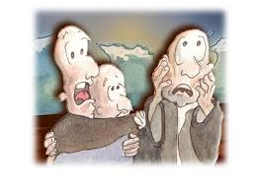
In Terrorem Clauses
An in terrorem clause in a will does not apply in Pennsylvania if the beneficiary contesting the will has "probable cause" for initiating the contest.
This principle is codified in 20 Pa.C.S.
§ 2521 which states that such clauses are unenforceable if probable cause exists for instituting proceedings.

Slide 21
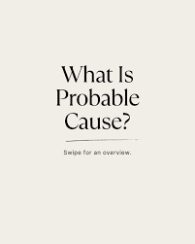
In Terrorem Clauses
Probable cause in this context is defined as a reasonable belief, based on facts, that the claim or contest is valid under existing or developing law.
Estate of Powell, 2019 PA Super 140.

Slide 22

In Terrorem Clauses
Forfeiture clauses are valid but strictly construed.

Slide 23

TedPerkinsTax News
Verify Your Attendance
Please type “present” into the chatbox on your screen and hit ENTER.
This is an important step which verifies your attendance and assures that your credit is received.
Thank you.

Slide 24
Basis for Bringing a Will Contest

Slide 25

Legal Grounds for Bringing
a Will Contest
1. Lack of Testamentary Capacity
  2. Undue Influence
  3. Fraud or Mistake
4. Forgery
5. Lack of Proper Execution
6. Lack of Testamentary Intent

Slide 26
Legal Grounds for Bringing
a Will Contest
1. Lack of Testamentary Capacity
  2. Undue Influence
  3. Fraud or Mistake
4. Forgery
5. Lack of Proper Execution
6. Lack of Testamentary Intent

Slide 27
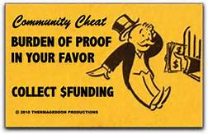
Initial Burden
The initial burden is on the proponent to “prove” the will
In a will contest, you cannot use a self-proving clause to prove due execution.
It will be necessary to prove the execution of the will by the testimony of two (2) witnesses.
This is called the “two witness rule”

Slide 28

Burden of Proof
Once execution of a will is proven by the required two witnesses, a presumption of validity arises which can only be overcome by clear, strong and compelling evidence.

Slide 29

“Clear and Convincing” Evidence
"The witnesses must be found to be credible, that the facts to which they testify are distinctly remembered and the details thereof narrated exactly and in due order, and that their testimony is so clear, direct, weighty and convincing as to enable the jury to come to a clear conviction, without hesitancy, of the truth of the precise facts in issue."

Slide 30
Lack of Testamentary Capacity

Slide 31

What Constitutes “Testamentary Capacity”
First, a testator must be at least 18 years of age in order to have testamentary capacity.
A testator over the age of 18 then must be of “sound mind” in order to execute a valid will.
Testamentary capacity relates to the soundness of the testator’s mind.

Slide 32
The Test for Testamentary
Capacity
Whether or not the testator appreciates, in general way :
The nature and extent of his or her estate (property in possession);
Appreciates who his or her natural and close relations are (those close relatives that would be the natural objects of his or her bounty); and
Indicates an intelligent understanding of the disposition he or she desires to make of his or her estate.

Slide 33

The Key Question
Did the Testator meet the Test at the time he or she Executed the Will in Question?

Slide 34
The Evidence Considered

Slide 35

Evidence of Capacity
Generally, any evidence which will aid in determining whether the testator lacked testamentary capacity at the time he or she executed the purported will is admissible.
However, the evidence offered must still meet the standards of competency and relevancy.
The weight to be accorded evidence varies with its bearing upon the question of testamentary capacity.

Slide 36
Evidence of Capacity
All evidence of capacity or lack of capacity must relate reasonably to the time of execution of the will.
In most if, not all cases, the evidence discussed will not in itself be considered conclusive as to the issue …
…but may nevertheless be considered as relevant, …
…and weighed by the court in deciding the issue.

Slide 37

You Have the Testator!!!
...and the opportunity to create direct contemporary evidence

Slide 38
Evidence Considered
Physical and Mental Condition of the Testator
Ability to Transact Business
Adjudication of Incompetency or Insanity
Old Age
Memory/Loss of Memory
Weakness of intellect
Physical Weakness
Drug or Alcohol Use
Eccentric Behavior
Absurd Beliefs

Slide 39
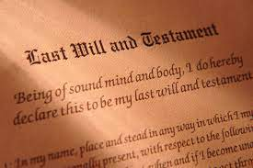
The Will as Evidence
When capacity is at issue, courts generally will examine the disputed document to ascertain whether in the court’s opinion the testamentary scheme is natural, reasonable and in harmony with the family background.
If the document makes what the court feels are natural and reasonable dispositions, there is a better chance that the requisite capacity will be found.
Unreasonable or unnatural dispositions, with other evidence, may be used to prove incapacity, but, standing alone, are insufficient except where the disposition is so gross or ridiculous as to give rise to a presumption of incapacity.

Slide 40
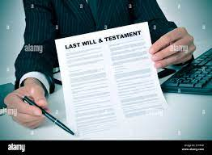
Out of Court Declarations - Declarations of the Testator
The declarations of the testator, made within a reasonable time before and after the execution of the will…
…have always been received in evidence upon a question of testamentary capacity, to show the state and condition of the testator's mind…

Slide 41

Instructions of the Testator
The testator’s instructions for the drafting of the will at a date prior to that of execution may be indicative of -
His or her awareness of the natural objects of his or her bounty,
The general composition of his or her estate, and
What he or she wants done with it.

Slide 42

The Scrivener’s Testimony
The draftsman of a will is always important and may be the most important witness in a contested will case.
However, where the attorney who draws a will participates in the trial of a contest upon the instrument, his or her testimony cannot be considered disinterested.

Slide 43

Out-of-Court Declarations - Subscribing Witnesses-
Great weight is ascribed by the courts to the testimony of
Subscribing witnesses, and
Others who might happen to be present at the time of execution.
A subscribing witness may state his or her opinion as to capacity without stating the facts upon which such opinion is based.

Slide 44

Observations of Third Parties
Ordinary witnesses may state their opinions as to the mental condition or capacity of the testator, providing such opinion is :
Rationally based on the witness’s perception;
Helpful to clearly understanding or to determining a fact in issue; and
Not based on scientific, technical, or specialized knowledge.

Slide 45

Observations of Third Parties
Generally, a witness is required to state first the facts upon which his or her opinion is based, …
…so that it may be made to appear whether the supporting testimony is relevant and…
…of sufficient significance to warrant the formation of an opinion.
Unlike an expert witness, a lay witness, on the other hand, may not base his or her opinion on a hypothetical state of facts.

Slide 46

Medical Testimony Concerning Mental Capacity

Slide 47
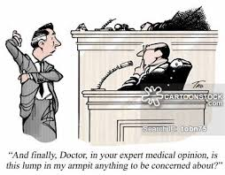
Overview
Medical testimony in any type of proceeding is always divided into two (2) categories.
The first category is testimony of treating physicians.
The testimony of treating physicians is based upon their own treatment and examination of the patient.
The second category of medical testimony is expert witness testimony presented by medical experts based upon a set of facts or circumstances in evidence.
In this category, the medical testimony is based upon hypothetical questions posed to the doctor, but the hypothetical questions must be based upon facts that are in evidence.

Slide 48

The Treating Physician
There is Pennsylvania case law to the effect that the testimony of medical experts who have observed the testator within that time frame must be given weight equal to the testimony of the attorney-scrivener who was present during the execution of the will.

Slide 49
Expert
Witness Testimony
Comparatively little weight is given to the testimony of medical experts who do not have direct knowledge of the facts and have not examined the testator.
This testimony is generally allowed, but the weight to be given this testimony is within the discretion of the trier of fact.

Slide 50

Applicability of the
Mental Health Procedures Act
The Mental Health Procedures Act has confidentiality provisions that provide that all documents concerning persons in treatment shall be kept confidential and may not be released without the patient’s written consent.
Frequently, people trying to contest a decedent’s will try to obtain the decedent’s mental health records.
Pennsylvania Courts have ruled that the confidentiality provisions are not affected by the decedent’s death.

Slide 51
Applicability of the
Mental Health Procedures Act
Dementia, including conditions such as senility, is not classified as a mental illness under the Pennsylvania Mental Health Procedures Act (MHPA) unless it is accompanied by a diagnosis of mental illness. The MHPA explicitly states that conditions such as senility, alcoholism, or drug dependency do not, by themselves, constitute mental illness.
The Superior Court has ruled that an heir cannot waive the confidentiality provisions of the Mental Health Procedures Act in order to secure documents which might assist in contesting the validity of the decedent’s will.

Slide 52

The Privacy Rule Under HIPAA
.
Covered entities may disclose protected health information in a judicial or administrative proceeding if the request for the information is through an order from a court or administrative tribunal.
Such information may also be disclosed in response to a subpoena or other lawful process if certain assurances regarding notice to the individual or a protective order are provided

Slide 53

Did the Testator meet the Test at the time he or she Executed the Will in Question?
> Conduct a colloquy with the testator
Who are your family members?
What is the nature of your estate?
What do you want to do with your property?
> Create a contemporaneous Memorandum
> Ask the Subscribing witnesses to do the same
> Have the testator examined by a medical professional
> Have the testator draft a “letter of intent” explaining why

Slide 54
1.14 Client with Diminished Capacity
(a) When a client's capacity to make adequately considered decisions in connection with a representation is diminished, whether because of minority, mental impairment or for some other reason, the lawyer shall, as far as reasonably possible, maintain a normal client-lawyer relationship with the client.
(b) When the lawyer reasonably believes that the client has diminished capacity, is at risk of substantial physical, financial or other harm unless action is taken and cannot adequately act in the client's own interest, the lawyer may take reasonably necessary protective action, including consulting with individuals or entities that have the ability to take action to protect the client and, in appropriate cases, seeking the appointment of a guardian ad litem, conservator or guardian.

Slide 55

What About Videotaping the Will Signing?

Slide 56
TedPerkinsTax News
Verify Your Attendance
Please type “present” into the chatbox on your screen and hit ENTER.
This is an important step which verifies your attendance and assures that your credit is received.
Thank you.

Slide 57
Undue Influence

Slide 58

The Key Question
Did the Testator Intend to Execute the Will at issue as his or her Last Will and Testament of his or her own free will?

Slide 59

Alternative Ways to Prove Undue Influence
Undue influence may be proven in two ways:
> Directly, or
> Indirectly

Slide 60
Direct Proof of Undue Influence

Slide 61
Direct Proof of Undue Influence
If undue influence is to be proven by direct evidence, it must be shown that
> The act or acts of another individual destroyed the testator’s free agency, and
> Caused the testator to make a will that he or she would not otherwise have made.
Undue Influence and Causation

Slide 62

Defining Undue Influence
In order to establish undue influence to void a will on the ground of undue influence, there must be:
> imprisonment of the body or mind, fraud, threats, misrepresentations, circumvention, inordinate flattery, or physical or moral coercion,
> to such a degree as to prejudice the mind of the testator, or destroy his or her free agency, in the making of the will.

Slide 63

Defining Undue Influence
The term “undue influence” does not refer to all conduct capable of swaying the testator in one’s favor but rather to:
An intentional act or acts
Intended to produce and
Which does produce a testamentary writing
That the testator would not have made but for such influence.

Slide 64

Causation
The case law also requires proof of “causation”.
That is proof that the exercise of influence over the testator led to the execution of a will which the testator would not have otherwise executed.
Where it does not appear that the efforts of the proponent influenced the testator in with respect to the execution of the will itself undue influence will not be found.

Slide 65

Evidence Considered
Because undue influence has been described as subtle, intangible, yet recognizable by human experience undue influence is rarely susceptible of direct proof.
Seldom does a single fact result in the court voiding a will based on undue influence.
It is rather a consideration of the totality of the circumstances surrounding the will which is more often the court’s frame of reference.

Slide 66

Specific Acts Considered
Opportunity Not Enough
Solicitations
Acts of Kindness
Misconduct and Ill-Treatment
Denying Access to the Testator

Slide 67

Circumstances Surrounding the Execution of the Will
The Mental and Physical Condition of the Testator
The Scrivener
Proponent’s relationship to the Testator
Proponents’ participation in the preparation of the Will
Contents of the Will
Contents of prior Wills
Republication and Opportunity to Revoke
Actions and Declarations of the Beneficiaries

Slide 68

Influence at the Time of Execution
Evidence as to the presence of undue influence at the time the will was executed is most relevant.
However, evidence for a reasonable period of time prior to and after the execution of the will, may also be considered.

Slide 69

Testator’s Declarations That She Did Not Execute the Will Freely
Declarations of the testator, such as:
that he or she did not execute the will freely,
that he or she never intended to have made such a will, and
similar declarations offered as evidence of undue influence are generally inadmissible as hearsay to prove undue influence.

Slide 70
Testator’s Declarations That She Did Not Execute the Will Freely
For the declarations of a testator to be considered at all, upon an issue of undue influence, …
…there must be proof of other facts and circumstances indicating circumvention or fraud in the procurement of the will.
Such declarations are admissible, not as proof of the fact of undue influence, but rather to show that the surrounding circumstances created opportunities for exercising that influence.

Slide 71
TedPerkinsTax News
Verify Your Attendance
Please type “present” into the chatbox on your screen and hit ENTER.
This is an important step which verifies your attendance and assures that your credit is received.
Thank you.

Slide 72
Indirect Proof of Undue Influence

Slide 73

Three Requirements to Prove Indirect Undue Influence
A person who is in a confidential relationship with the testator,
Receives a substantial benefit under the proposed Will, and
At or around the time the Will was executed the testator had a weakened mental intellect…
….a presumption of undue influence arises and the burden of proof shifts to the proponent to prove the absence of undue influence.

Slide 74

The Burden of Proof
First - Proof of due execution or admission of the probate record shifts the burden to contestant and raises a presumption of the absence of undue influence.
Second - If the contestant meets proves the three requirements by clear and convincing evidence…
Finally …. the burden of proof shifts back to the proponent to produce clear and convincing evidence which demonstrates affirmatively the absence of undue influence.
C

Slide 75

What Constitutes A Confidential Relationship
Although no precise formula has been devised to ascertain the existence of a confidential relationship, it has been said that such a relationship is not confined to a particular association of parties,
…but exists whenever one occupies toward another such a position of advisor or counselor as reasonably to inspire confidence that he will act in good faith for the other's interest."

Slide 76

Confidential Relationship
Confidential Relationship
Presumed as a Matter of Law:
Scrivener and testator
Trustee
Guardian and Ward
Other Relationships
Kinship or Marriage
Physician
Banker
Nurses
Attorney in Fact
Power of Attorney
Accountant

Slide 77

How is Substantial Benefit Defined
What is a substantial benefit must be determined by the facts and circumstances of each case, and "no hard and fast rule can be laid down."
The rationale for the requirement of a "substantial benefit" is that the benefit "must be of sufficient size to lend credence to the position that undue influence is presumed to have been exerted... “

Slide 78
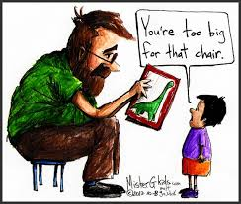
Weakened State of Mind
It is a relative state...
….if the intellect of the testator is substantially impaired in comparison to that of the proponent or beneficiary …
… it must be regarded as weakened since there could be no equal dealings between the two parties."

Slide 79

Did the Testator Intend to Execute the Will at issue as his or her Last Will and Testament of his or her own free will?
> Conduct an interview with the testator
What is your living situation?
Who do you rely on for support?
Has anyone asked you to include a particular provision in the Will?
Is the Client isolated from family and friends
>Create a contemporaneous Memorandum
>Document the physical and mental condition of the Client
>Don’t let someone else pay your invoice
>Look out when one child brings the Client to your Office
>Have the testator draft a “letter of intent” explaining why
>Prior statements made by testator as to his or her testamentary intentions in the disposition of his or her property are also relevant
>Perform a Hypothetical Probate and have the Client confirm the disposition of their estate?

Slide 80
The End

Slide 81
Questions
If you have any questions
regarding this Course
Martin Pezzner
mpezzner@gibperk.com
Paul Fellman
pfellman@gibperk.com
or
Ted Perkins
tperkins@gibperk.com
or
(610) 565-1708 Ext. 104

Slide 82
COURSE EVALUATION
Thank you for attending our program.
You will receive an email which includes a link to the materials, the replay of the event, and the link to the Evaluations.
Please fill out the form, which helps us comply with the requirements of issuing CPE and CLE in various jurisdictions.

