Slide 1

Estate tax update 2026

Slide 2

EDWARD L. PERKINS, BA, JD, LLM(Tax), CPA
Founding Shareholder - Gibson & Perkins, PC
tedperkins@gibperk.com
610.565.1708 ext. 102
Adjunct Professor
Villanova University School of Law - Graduate Tax Program
Author
AICPA’s – Taxation of Trusts and Estates
AICPA’s – Fundamentals of Trusts
Drafting Wills That Work in Pennsylvania
PBI - Special Needs Trusts in Pennsylvania
PBI - The Pennsylvania Trusts Handbook
PBI - The ABCs of Will Contests – Co-Author Paul Fellman
Founder - YourOnlineProfessor.net

Slide 3
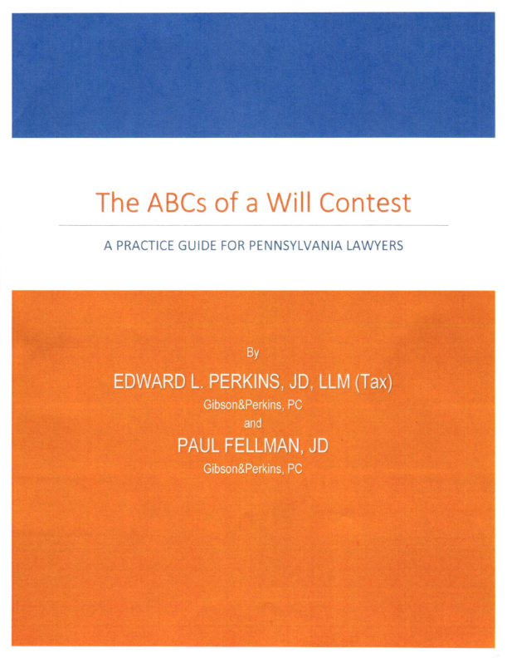
NOW AVAILABLE at PBI.org
Publications and Media/
Press Books
https://www.pbi.org/catalog?category=PBI-Press-Book

Slide 4

MARTIN J. PEZZNER, BS, JD, CPA
Gibson & Perkins, PC
mpezzner@gibperk.com
610.565.1708 ext. 112
Mr. Pezzner has a wealth of experience as a practicing attorney for over twenty-nine years. After graduating Wilkes College with a Bachelor of Science in accounting, he was employed by the Internal Revenue Service in Philadelphia, PA as a Tax Revenue Agent (Field Agent) for five years. He also worked for one year in the Philadelphia IRS Appeals Office. While employed by the IRS, he became a CPA (1985) in the Commonwealth of Pennsylvania. Mr. Pezzner received his Juris Doctorate Degree from the University of Dayton School of Law in 1989.
Mr. Pezzner is admitted to practice in the Commonwealth of Pennsylvania and the Eastern District of Pennsylvania. Well-versed in all aspects of law, he is especially knowledgeable in the realms of Estate Administration, Estate Planning, Business Matters, and Tax Controversies.
He is a member of the Philadelphia Bar Association and the Probate and Trust Law Section of the Philadelphia Bar. He also maintains his CPA license.

Slide 5

Suite 204
100 W Sixth Street
Media, PA 19063
610 565 1708
www.gibperk.com
www.youronlineprofessor.net

Slide 6

GIBSON&PERKINS, PC is a multi-practice law firm with offices in Pennsylvania and Delaware. Our firm has expanded from its founding in 2001, into a vibrant and growing law firm dedicated to serving an ever expanding and sophisticated client base.
We represent clients in matters pertaining to:
Business Transactions
Real Estate
Estate Planning
Estate Administration
Tax Problem Resolution
Emerging Businesses
Litigation

Slide 7
YourOnLineProfessor.net
CLE - Continuing Legal Education for
Attorneys:
YourOnlineProfessor.net is an Accredited Provider for Pennsylvania Continuing Legal Education, through The Supreme Court of Pennsylvania's Continuing Legal Education Board, registered as sponsor #7003.
This program qualifies as 1 hour - ‘Live Webcast’ under PA CLE Board guidelines and in the state of Delaware
In most cases, credit is also available to New York attorneys through New York’s “approved jurisdiction policy.”

Slide 8
YourOnLineProfessor.net
CPE - Continuing Professional Education for
CPAs:
YourOnlineProfessor.net is registered with the Pennsylvania Department of State's Bureau of Professional and Occupational Affairs as a Program Sponsor under the State Board of Accountancy. Our license number is PX177605.
This Course will count as 1.0 Hour of Group Internet Based or
Interactive Self Study Credit depending on how you access the Course.
For CPAs taking an archived version of the Course for Interactive Self Study Credit successful completion of a Final Examination is required. The Final Slide will direct you as to how to access and complete the Final Examination.

Slide 9

NASBA Registry of CPE Sponsors
YourOnlineProfessor.net is registered with the National Association of State Boards of Accountancy (NASBA) as a sponsor of continuing professional education on the National Registry of CPE Sponsors. State boards of accountancy have final authority on the acceptance of individual courses for CPE credit. Complaints regarding registered sponsors may be submitted to the National Registry of CPE Sponsors through its website: www.learningmarket.org.
Our Sponsor No. Identification Number 137573

Slide 10
Refund Policy
It is the policy of YourOnlineProfessor.net to satisfy participants and purchasers in a reasonable manner. Therefore, refunds to dissatisfied participants will be given in order to maintain good will. However, the reason for a participant's dissatisfaction and any resulting refund must be clearly indicated. Each refund request will be reviewed by a majority of the members of YourOnlineProfessor.net. A refund is always given if a course does not qualify for CPE credit in the state in which the purchaser seeks to apply it for credit.
Program Cancellation Policy
It is the policy of YourOnlineProfessor.net to refund any fees paid in full in the event that a scheduled program is cancelled or rescheduled.
Complaint Resolution Policy
All evaluations are reviewed by Edward Perkins. Grievance complaints are directed to Mr. Perkins at (610) 565-1708 ext. 102 or via email to yop@youronlineprofessor.org. It is the policy of YourOnlineProfessor.net to respond to every grievance complaint. This response shall include when appropriate: reviewing the grievance complaint in conjunction with other participant evaluations and discussion of the grievance complaint with the course instructor or other employees.

Slide 11
Where Applicable, this program is
© YourOnlineProfessor.net - All Rights Reserved.
This material is designed for informational purposes. In providing this material, neither the author nor YourOnlineProfessor.net are engaged in rendering legal, accounting or professional service. If legal, accounting, or professional service is required, the service of a competent professional should be sought.
Inquiries regarding the use of the material contained in
this Course should be addressed to:
Ted Perkins
tperkins@gibperk.com
Suite 204
100 W. Sixth Street
Media, PA 19063

Slide 12
Estate tax update 2026

Slide 13
Developments

Slide 14

One Big Beautiful Bill Act
Estate, gift, and GST exemption permanently set at $15 million per individual ($30 million for married couples) in 2026
Adjusted for inflation after 2026
Caution regarding the "permanent" nature of tax provisions

Slide 15
Year | Estate Tax Exclusion | Estate Tax Initial Rate (Above Exclusion) | Estate Tax Maximum Rate | Gift Tax Annual Exclusion
1977 | $120,667 | 30% | 70% | $3,000
1978 | $134,000 | 30% | 70% | $3,000
1979 | $147,333 | 30% | 70% | $3,000
1980 | $161,563 | 32% | 70% | $3,000
1981 | $175,625 | 32% | 70% | $3,000
1982 | $225,000 | 32% | 65% | $10,000
1983 | $275,000 | 34% | 60% | $10,000
1984 | $325,000 | 34% | 55% | $10,000
1985 | $400,000 | 34% | 55% | $10,000
1986 | $500,000 | 37% | 55% | $10,000
1987-1996 | $600,000 | 37% | 55% | $10,000
1997 | $600,000 | 37% | 60%[1] | $10,000
1998 | $625,000 | 37% | 60%[1] | $10,000
1999 | $650,000 | 37% | 60%[1] | $10,000
2002 | $1,000,000 | 41% | 50% | $11,000
2003 | $1,000,000 | 41% | 49% | $11,000
2004 | $1,500,000 | 45% | 48% | $11,000
2005 | $1,500,000 | 45% | 47% | $11,000
2006 | $2,000,000 | 46% | 46% | $12,000
2007-2008 | $2,000,000 | 45% | 45% | $12,000
2009 | $3,500,000 | 45% | 45% | $13,000
2010[2]-2011 | $5,000,000 | 35% | 35% | $13,000
2012 | $5,120,000 | 35% | 35% | $13,000
2013 | $5,250,000 | 40% | 40% | $14,000
2014 | $5,340,000 | 40% | 40% | $14,000
2015 | $5,430,000 | 40% | 40% | $14,000
2016 | $5,450,000 | 40% | 40% | $14,000
2017 | $5,490,000 | 40% | 40% | $14,000
2018 | $11,180,000 [3] | 40% | 40% | $15,000
2019 | $11,400,000 | 40% | 40% | $15,000
2020 | $11,580,000 | 40% | 40% | $15,000
2021 | $11,700,000 | 40% | 40% | $15,000
2022 | $12,060,000 | 40% | 40% | $16,000
2023 | $12,920,000 | 40% | 40% | $17,000
2024 | $13,610,000 | 40% | 40% | $18,000
2025 | $13,990,000 | 40% | 40% | $19,000
2026 | $15,000,000 [4] | 40% | 40% | TBD

Slide 16


Corporate Transparency Act Alive!!
National Small Business United v. U.S. Department of the Treasury (11th Cir. Dec 16, 2025)
CTA constitutionally regulates interstate commerce
Does not violate the Fourth Amendment

Slide 17
Corporate Transparency Act
In a major reversal, the U.S. Court of Appeals for the 11th Circuit has upheld the constitutionality of the Corporate Transparency Act (CTA), finding it to be a valid exercise of congressional power.
However, the practical effect of the decision may be limited, given a March 2025 Treasury interim final rule exempting “domestic reporting companies” and their beneficial owners from the law’s reporting requirements. (Nat’l Small Bus. United v. U.S. Dep’t of the Treasury, No. 24-10736, 2025 WL 3637295 (11th Cir. Dec. 16, 2025))
The CTA was signed into law in 2021 and takes aim at layered corporate structures that facilitate illicit activities, such as money laundering, fraud, and trafficking.
However, the CTA and its implementing beneficial ownership information (BOI) reporting regulations have faced constitutional challenges in several jurisdictions.
Tuesday’s decision out of the 11th Circuit may be a win for those seeking to uphold the law, but it doesn’t reinstate the broader BOI reporting requirements.
Notes:
Transparency International’s Scott Greytak called the 11th Circuit decision “a clear wake-up call” for Treasury. “With the law’s constitutionality now upheld at the appellate level, the Department’s choice to exempt over 99 percent of companies Congress sought to cover is a policy choice – not a legal necessity,” he added.
12/31/2024

Slide 18
Planning

Slide 19

Planning after the OBBB Act
Estate, gift, and GST exemption permanently set at $15 million per individual ($30 million for married couples) in 2026
Adjusted for inflation after 2026

Slide 20

Income Tax Considerations
Potential future basis step-up
Lifetime gifts receive transferred basis (no step-up)
Consider income tax consequences vs. estate planning goals

Slide 21
If your Estate is significantly under the Exemption Amount
Don’ t make lifetime gifts for tax purposes
Loss of Step- up in Basis
No Estate Tax savings
If your Estate is under the Exemption Amount but appreciation will take you over
Consider “freezing” techniques
If your Estate is over the Exemption Amount
Traditional techniques to reduce your taxable estate still apply
However, you retain low basis property
Ideal would be to retain the Exemption Amount

Slide 22

Use Estate Freeze Strategies
Gift to an Irrevocable Trust: Remove property from estate, pay income taxes to further reduce estate
Sale to an IDGT: Sell assets for promissory note, leverage low AFR (around 4.00%) or private annuity

Slide 23


Property with a $5,000,000 FMV at the Date of Gift or Sale
$8,000,000 at the Date of Death
Irrevocable Trust
Gift
IDGT
Sale
Promissory Note
or Private Annuity

Slide 24
Use Estate Freeze Strategies
Gift to an Irrevocable Trust: Remove property from estate, pay income taxes to further reduce estate
Sale to an IDGT: Sell assets for promissory note, leverage low AFR (around 4.00%) or private annuity
Gift to a SLAT: Spouse as initial beneficiary, creates safety net for married couple

Slide 25


$15,000,000
$15,000,000
SLAT
SLAT

Slide 26
Use Estate Freeze Strategies
Gift to an Irrevocable Trust: Remove property from estate, pay income taxes to further reduce estate
Sale to an IDGT: Sell assets for promissory note, leverage low AFR (around 4.00%) or private annuity
Gift to a SLAT: Spouse as initial beneficiary, creates safety net for married couple
IRC Sec 2702 corporate freeze

Slide 27

Use the GST Exemption
Utilize GST exemption with a Dynasty Trust
Incorporate limited powers of appointment
GST exemption is non-portable between spouses

Slide 28


$15,000,000
$15,000,000
Generation
No.1
Generation
No.1
Generation
No.2
Generation
No.2
Generation
No.3
Generation
No.3

Slide 29

Include Provisions for Adapting to Future Changes
Limited powers of appointment
Trust protector provisions
Discretion to grant testamentary general power of appointment
Allow for basis step-up opportunities

Slide 30
Ways to Make a Gift and Still Achieve Step Up in Basis
Transfers to Revocable Trusts
Transfer to a Trust Retaining Control over Income or Principal
Transfer to a Trust Retaining a Reversionary Interest
Transfer stock retaining the right to vote stock in a "controlled corporation"

Slide 31
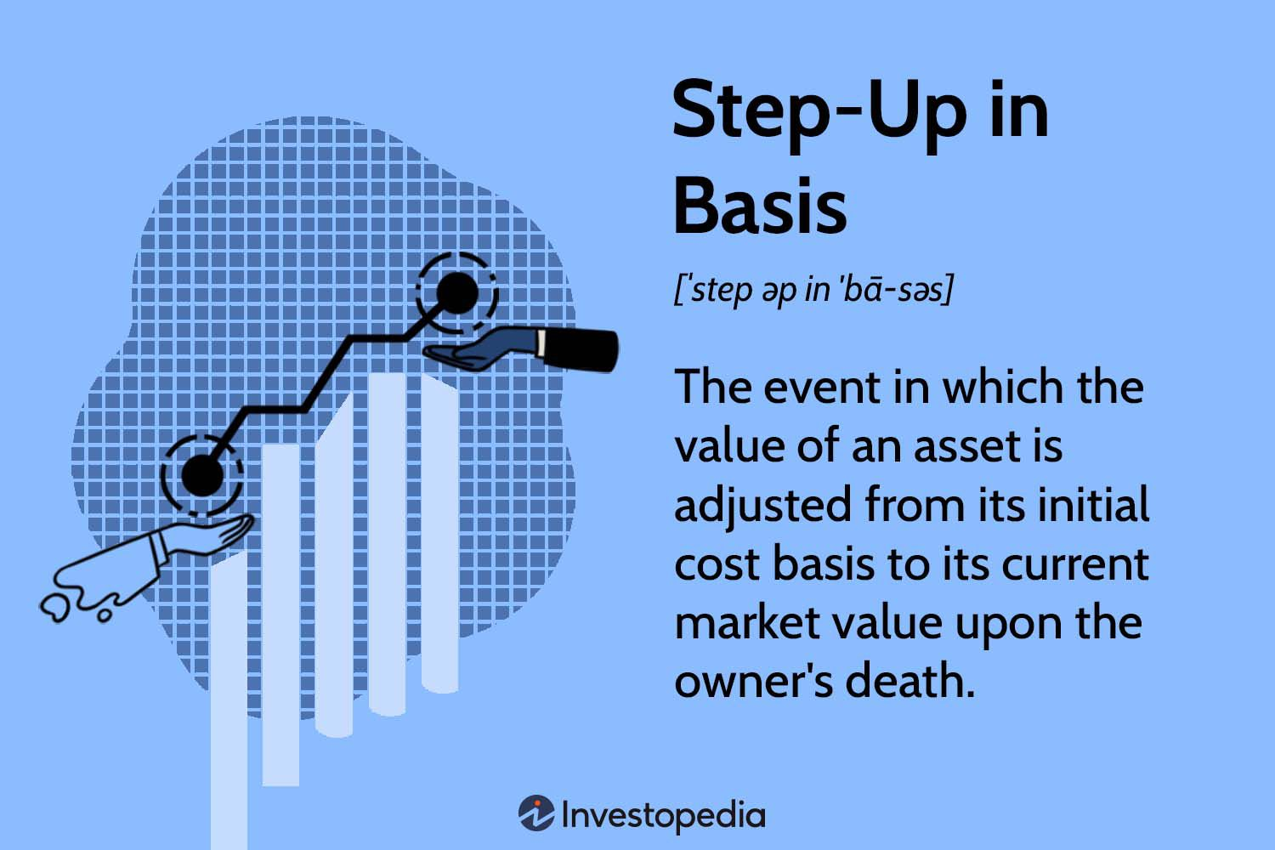
Take Advantage of Portability
File federal estate tax return for deceased spouse
Transfer unused exemption to surviving spouse
Low cost compared to potential future savings
Provides evidence for basis step-up
Notes:
The IRS has issued Form 8971 “Information Regarding Beneficiaries Acquiring Property From a Decedent” and instructions. This increases the duties of a personal representative or executor of a decedent’s estate.
Form 8971 is required to be filed if an estate has to file an estate tax return under Form 706 after July 31, 2015. Form 8971 should be filed separately from the 706 and not attached to the Form 706.

Slide 32

Please Verify your Attendance

Slide 33
IRS Pronouncements

Slide 34


2026 Inflation Adjustments
• 2026 lifetime estate and gift tax exemption: $15 million
OBBBA makes higher figure permanent with inflation adjustments
• Annual gift tax exclusion: $19,000 per donee in 2026
• IRC Sec. 2032A -Special-use valuation: $1,460,000 aggregate decrease limit
• Gifts from foreign corporation or partnership reporting threshold: $20,116
• IRC Sec. 6166 - Estate tax installment interest: Tax on $1,940,000 "2% portion"
Notes:
For gifts or bequests from a nonresident alien or foreign estate, you are required to report the receipt of such gifts or bequests only if the aggregate amount received from that nonresident alien or foreign estate exceeds $100,000 during the taxable year. If the gifts or bequests exceed $100,000, you must separately identify each gift in excess of $5,000.
Form 3520
For purported gifts from foreign corporations or foreign partnerships, you are required to report the receipt of such purported gifts only if the aggregate amount received from all entities exceeds $18,567 for 2023 and $19,570 for 2024 (adjusted annually for inflation). You must separately identify each gift and the identity of the donor. Note that the IRS may recharacterize purported gifts from foreign corporations or foreign partnerships.
Preferential interest rates apply, including a 2% rate on the tax attributable to the first $1 million of taxable value (inflation-adjusted, e.g., about $1.9 million in 2025), with the remaining deferred tax subject to an interest rate equal to 45% of the standard IRS underpayment rate.

Slide 35

Sec. 2801 Inheritance Tax on Covered Expatriates
Final regulations effective Jan. 1, 2025
Tax imposed on U.S. persons receiving gifts/bequests from “covered expatriates”
Flat 40% tax rate on total value
Recipient pays tax (no lifetime exemption)
Rebuttable presumption for gifts from foreign persons
Form 708 reporting requirement
Exceptions for marital deduction transfers
Notes:
A covered expatriate is an individual who meets specific criteria under U.S. tax law when relinquishing their U.S. citizenship or terminating lawful permanent resident status (green card).

Slide 36

2024 Form 709 updates and potential 2025 e-filing
The 2024 Form 709 changed the requirements for spouses electing to split gifts for gifts made in calendar year 2024.
Specifically, Part 1, entries 12 through 18, were moved to a new Part III, “Spouse’s Consent on Gifts to Third Parties,” on the second page of the donor spouse’s Form 709.
Additionally, the consenting spouse is no longer required to sign the donor spouse’s return on Page 1 but must instead sign a separate Notice of Consent to be attached to the donor spouse’s return.
Notes:
Line 7. Consent of Spouse
You must indicate spousal consent for gifts made to third parties to be considered as made one-half by each spouse by using thecheckbox, and attaching a Notice of Consent. Your spouse (the consenting spouse) must sign the Notice of Consent for your gift-splitting election to be valid.
The Notice of Consent must be signed and dated by the consenting spouse and must include a statement signifying consent to treat all gifts made to third parties as having been made one-half by each spouse, such as

Slide 37
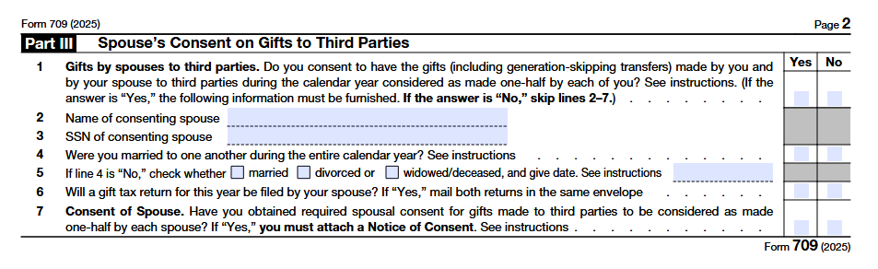

Slide 38

Letter Ruling 202509010
Ltr Ruling delt with the income tax consequences of a trust termination
No negative gift or GSTT consequences
Unfavorable income tax consequences for lifetime beneficial interest holder

Slide 39
$50,000
Irrevocable Trust
9/25/1985
Grandchild
Annuity
Upon termination of Trust, all trust property is required to be distributed per stirpes to the lineal issue of Grandchild, outright and free of the Trust
A B
The Proposed Distribution would effectively constitute a sale of the Grandchild’s and the Successor Remaindermen’s interests to the Current Remaindermen,
1
A B
Current Remainder
(Children of the Grandchild)
2
The IRS noted that the amount realized by the Current Remaindermen from the exchange of property for Trust interests held by the Grandchild and the Successor Remaindermen would be equal to the fair market value of the Proposed Distribution made to both the Grandchild and the Successor Remaindermen.
$100,000
1
C D E F
Successor Remaindermen (Grandchildren of the Grandchild)
$25,000

Slide 40
Trust Termination
The IRS found that the termination and proposed distribution did not cause beneficial interests to be shifted to another beneficiary in a lower generation than the beneficiaries who held the interests prior to the transaction.
As such, the trust and any distributions from it were not subject to GSTT pursuant to Sec. 2601.
Additionally, the IRS found that, assuming the actuarial value was an accurate representation of each beneficiary’s beneficial interest under the trust, the beneficial interests, rights, and expectancies of the beneficiaries would be substantially the same both before and after the termination and proposed distribution.
Thus, no beneficiaries were found to have made taxable gifts pursuant to Sec. 2501.

Slide 41
Trust Termination
However, the IRS applied the substance–over–form doctrine and found that although actuarial values were used to determine distributions of the trust upon termination, in substance it was a sale by G3 and G5 to the G4 beneficiaries and an exchange between the G4 and the other beneficiaries.
Further, the IRS applied the “no basis rule” under Sec. 1001(e), which disregards the basis in the income interest when the entire interest in the trust is not transferred to a third party, resulting in the entire amount realized being recognized as long–term capital gain under Sec. 1222(3).

Slide 42

IRS Letter 627
Verifies Form 706 acceptance or agreed audit changes
Alternative: estate tax return transcript via Transcript Delivery Service
Transcription code 421 confirms acceptance
Wait at least nine months after filing
Notes:
TC 420: Examination Indicator, which reflects that the return is under examination consideration.
TC 424: Examination Request, which may also indicate the return is under review.
TC 421: Crucial differentiator. If you see TC 421 ("Closed examination of tax return"), it means the audit is finished or the return has been accepted as filed. If 421 is not present and 420 is, the return is still under review.

Slide 43
Cases

Slide 44

Estate of Rowland v. Commissioner, T.C. Memo. 2025-76 (July 15, 2025)
DSUEA denied due to late and incomplete estate tax return
Failed statutory requirement and Rev Proc 2017-34 safe harbor
No valuation for estate assets
Notes:
Generally, “the due date of an estate tax return required to elect portability is nine months after the decedent's date of death or the last day of the period covered by an extension (if an extension of time for filing has been obtained).“ Treas. Reg. §20.2010-2(a)(1). As relevant here, the IRS offered an additional safe harbor, providing that “a complete and properly prepared“ estate tax return would be considered timely if filed “on or before the later of January 2, 2018, or the second [*7] annual anniversary of the decedent's date of death.“ Rev. Proc. 2017-34, §4.01(1), 4.02, 2017-26 I.R.B. at 1284.
A return is considered “complete and properly prepared if it is prepared in accordance with [Treasury Regulation] §20.2010-2(a)(7).“ Id. §4.01(1). For its part, Treasury Regulation §20.2010-2(a)(7)(i) pins the meaning of “complete and properly prepared“ to (1) compliance with “the instructions issued for the estate tax return (Instructions for Form 706)“ and (2) satisfaction of “the requirements of [Treasury Regulation] §§20.6018-2, 20.6018-3, and 20.6018-4.“ Both parties focus on the former requirement.
Nor can Fay's Return shelter under the special rule set forth in Treasury Regulation §20.2010-2(a)(7)(ii).
This rule relaxes valuation reporting requirements, but with respect to only marital and charitable deduction property. Id.
At best, it would allow Fay's Estate to estimate the value of only certain assets and does not obviate the need to comply with the detailed reporting requirements for assets that did not pass to either Mr. Rowland or charity.

Slide 45
Portability
  A return is considered “complete and properly prepared if it is prepared in accordance with [Treasury Regulation] §20.2010-2(a)(7).“ Id. §4.01(1). For its part, Treasury Regulation §20.2010-2(a)(7)(i) pins the meaning of “complete and properly prepared“ to (1) compliance with “the instructions issued for the estate tax return (Instructions for Form 706)“ and (2) satisfaction of “the requirements of [Treasury Regulation] §§20.6018-2, 20.6018-3, and 20.6018-4.“ Both parties focus on the former requirement.
  Nor can Fay's Return shelter under the special rule set forth in Treasury Regulation §20.2010-2(a)(7)(ii).
  This rule relaxes valuation reporting requirements, but with respect to only marital and charitable deduction property.

Slide 46
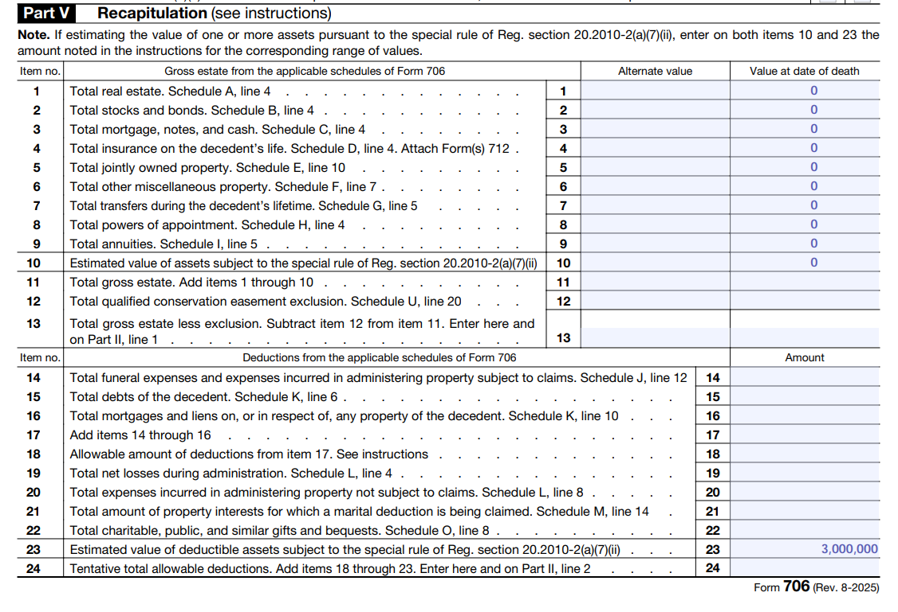

Slide 47

United States v. Lipson, 2025 WL 947530 (D. Nev March 28, 2025)
Estate tax deficiency collection from multiple sources
Liability of successor personal representative
Liability of successor trustee
Personal liability under Nevada community property law
Notes:
U.S. District Court held that a decedent's estate tax deficiency could be recovered from the decedent's estate, the decedent's revocable trust, the estate of decedent's executor who filed the estate tax return, and the surviving spouse of the decedent's executor who filed the estate tax return.

Slide 48
Liability for Estate Tax
U.S. District Court held that a decedent's estate tax deficiency could be recovered from the decedent's estate, the decedent's revocable trust, the estate of decedent's executor who filed the estate tax return, and the surviving spouse of the decedent's executor who filed the estate tax return.

Slide 49
X
Estate of Jean Lipson
Tax Deficiency
$566,041
David Lipson,
Personal Representative
Personal representative of David Lipson Estate
$2,161,849
X
ABRA LP
Jean Lipson
Trust
Dfoavid Lipson,
Trustee

Slide 50

Estate of Galli – Intrafamily Notes
March 5, 2025 Tax Court decision
$2.3 million intrafamily loan classified as loan, not gift
Note had adequate interest at AFR, specified repayment date
Sufficient formalities upheld loan characterization
Notes:
In Estate of Galli,27 Barbara Galli loaned $2.3 million to her son in 2013 when she was 79 years old. The terms of the loan provided for a nine–year term with interest at the applicable federal rate (AFR) of 1.01%, payable annually and with repayment of the principal due at the end of the term. Galli’s son made annual payments of interest for three years until Galli died in 2016. Galli had not filed a gift tax return relating to the note and left a taxable estate that included the repayment obligation under the note, which the estate valued at $1,624,000.
The IRS argued that the FMV of the note was $869,000 higher than what the estate reported as of Galli’s date of death and that this excess amount was a gift and not a loan. The IRS argued that the note did not create a legally enforceable right in Galli to repayment from the son and that Galli failed to show that her son had the ability to repay the loan or whether Galli intended to be repaid.
The Tax Court determined that the estate provided sufficient evidence to classify the note as a loan rather than a gift. Specifically, the note was signed by both parties, included adequate interest at the AFR, specified a repayment date, and the son had actually made annual interest payments for several years.
Although this decision is favorable for taxpayers, planners should remain cautious when structuring intrafamily notes as bona fide loans that will hold up against IRS scrutiny. Clients should administer the note in a manner consistent with arm’s–length transactions by strictly adhering to the formalities of the note, including proper documentation, charging adequate interest, specifying a fixed repayment schedule, and ensuring that payments are actually made in accordance with the terms. Additionally, it is important to avoid any prearranged agreement between the family members that the note will be forgiven or not enforced.

Slide 51
Intra Family Notes
Although this decision is favorable for taxpayers, you should remain cautious when structuring intrafamily notes as bona fide loans that will hold up against IRS scrutiny.
Clients should administer the note in a manner consistent with arm’s–length transactions by strictly adhering to the formalities of the note, including proper documentation, charging adequate interest, specifying a fixed repayment schedule, and ensuring that payments are actually made in accordance with the terms.
Additionally, it is important to avoid any prearranged agreement between the family members that the note will be forgiven or not enforced.

Slide 52
The Nine "Miller Factors"
The case is significant for consolidating the factors courts use to differentiate a debt from a gift.
These factors, which are highly dependent on the specific facts of a case, include:
• The presence of a promissory note or other evidence of debt.
• Whether interest was charged.
• If security or collateral was provided.
• The existence of a fixed maturity date.
• Whether a demand for repayment was made.
• If actual repayment occurred.
• The borrower's ability to repay.
• Maintenance of records reflecting the transaction as a loan.
• How the transaction was reported for federal tax purposes.

Slide 53

Estate of Spizzirri
May 16, 2025 Eleventh Circuit decision
Payments to stepchildren under prenuptial agreement not deductible
Failed bona fide requirement under Sec. 2053(c)(1)(A)
Evidence of donative intent
Notes:
On May 16, 2025, the Eleventh Circuit filed its decision in Estate of Spizzirri28 and affirmed the Tax Court’s decision that payments by a decedent’s estate made pursuant to a premarital agreement to his surviving spouse’s children from a previous marriage were not deductible as claims against the estate.
Richard Spizzirri entered into a prenuptial agreement with his fourth wife, Holly Lueders. The agreement, as later modified, required Spizzirri’s estate to pay $6 million to Lueders and $3 million to her three children from a prior marriage upon his death.
After Spizzirri’s death, his estate paid the stepchildren $1 million each and claimed a deduction for these payments as claims against the estate under Sec. 2053(a)(3). The IRS disallowed the deduction, and the estate petitioned the Tax Court for review. The Tax Court found, and the Eleventh Circuit affirmed, that the payments to the stepchildren were not deductible, as they were not contracted for bona fide, adequate, and full consideration in money or money’s worth as required by Sec. 2053(c)(1)(A). The Eleventh Circuit agreed with the Tax Court that the payments to the stepchildren failed the “bona fide” requirement. The court found evidence of donative intent, including Richard’s history of making gifts to his stepchildren. The court noted that such a “transfer that is essentially donative in character (a mere cloak for a gift or bequest)” is denied an estate deduction.29

Slide 54
Payments to family members, especially those arising from prenuptial or similar agreements
Payments to family members, especially those arising from prenuptial or similar agreements, will be closely scrutinized by the IRS to determine if they are truly bona fide or merely disguised gifts or bequests.
For a claim to be deductible, there must be clear evidence of a bona fide, arm’s–length agreement supported by adequate and full consideration in money or money’s worth.
Planners should carefully structure and document any such arrangements, ensuring that they meet the strict requirements of Sec. 2053 and the accompanying regulations to avoid disallowance of deductions and potential estate tax exposure.

Slide 55
Please Verify your Attendance

Slide 56

Estate of Griffin, T.C. Memo. 2025-47
Missed QTIP election resulted in loss of marital deduction for $2 million bequest
$300,000 bequest qualified as separate trust under Kentucky law
Not a terminable interest

Slide 57
QTIP Election
The executor of the estate timely filed Form 706 but did not list any property from the estate as QTIP.
The form’s Schedule M indicated that “all other property” included the specific bequest of $2.3 million to Creel. T
The IRS sent a notice of deficiency to the estate and maintained that both bequests, the $2 million and the $300,000 bequest in the revocable trust, were not eligible for the estate tax marital deduction.
The Tax Court determined that the $2 million bequest was a terminable interest and therefore includible in Griffin’s estate because the estate did not make the required valid QTIP election.
The Tax Court noted that a terminable interest does not qualify for the marital–deduction exception unless the QTIP election is made.

Slide 58
QTIP Election
You should pay close attention when drafting marital trust agreements to ensure they will qualify for the estate tax marital deduction.
Executors must make a valid QTIP election for most marital trusts to qualify for the estate tax marital deduction.
Complete Schedule M: On Schedule M (Form 706), the executor must list the specific assets for which the QTIP election is being made.
Place Assets in Box A: The assets intended to be part of the QTIP election must be specifically listed in Box A ("QTIP property") of Schedule M.
Listing them in Box B ("All other property") results in a failure to make the required election.

Slide 59
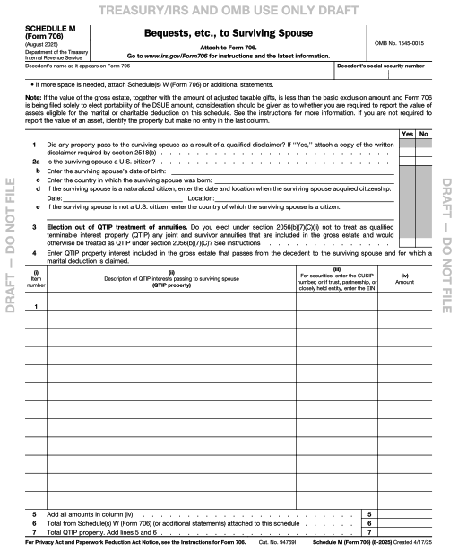
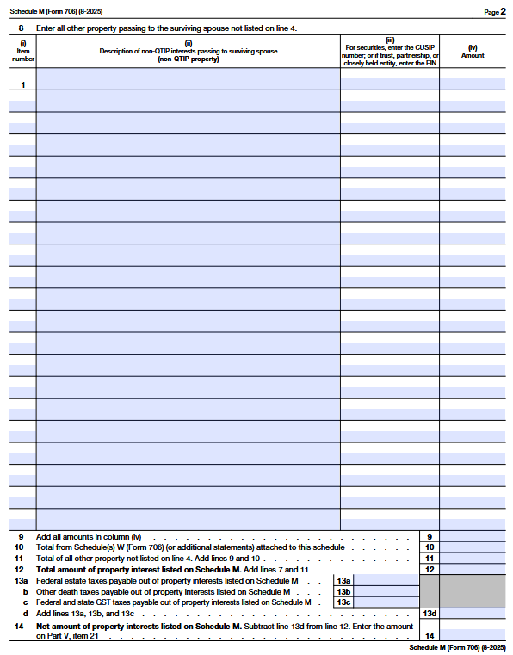

Slide 60

Pierce, T.C. Memo. 2025-29
Gifts of S Corp shares properly valued
Tax Court accepted taxpayer's expert valuation
Rejected IRS expert's higher valuation

Slide 61
S Corp Valuation
The Court used the income approach, and specifically the discounted cashflow method, as the proper method to value Mothers Lounge.
The discounted cashflow method determines the value of the business by adding the present value of projected cashflows for a discrete period, the present value of the business's terminal value, and the nonoperating assets of the business.
Projected cash flows for a discrete period
Determine the discount rate to determine present value
Apply the discount rate to the projected cash flows to determine the terminal value of the company
Add the value of non-operating assets such as excess cash.

Slide 62
Earning “Tax Affected”
One method to apply tax affecting to an S corporation's earnings is through the Delaware Chancery method.
This method of tax affecting applies a reduced fictitious tax rate at the entity level to account for the lower overall tax burden of a passthrough entity.
This fictitious tax rate is based on the ratio of overall passthrough entity taxes (individual tax rates) compared to the overall C corporation tax rate (corporation tax rates and shareholder-level tax rates).
This method accounts for the burdens of current tax that the owner might owe on the entity's earnings and the benefits of future dividend tax avoided.
This ratio is applied to the C corporation tax rate to estimate the fictitious entity-level tax rate.
Also allowed a 5% lack of control discount
And a 25% lack of marketability discount

Slide 63

The End

Slide 64

Questions
If you have any questions
regarding this Course
Martin Pezzner
mpezzner@gibperk.com
Ted Perkins
tperkins@gibperk.com
or
(610) 565-1708 Ext. 104

Slide 65
COURSE EVALUATION
Thank you for attending our program.
You will receive an email which includes a link to the materials, the replay of the event, and the link to the Evaluations within 24 hours.
Please fill out the form, which helps us comply with the requirements of issuing CPE and CLE in various jurisdictions.

